Slide 1
Movie Recommender System
Wajahat Sheikh | DSC680 Bellevue University

Slide 2
Why is this important?
Recommendation Systems are systems which work to give us relevant suggestions to product users.
They are important for every users now a days. There are many choices given to users in the field of dinning, movies, shopping but giving the best option to user is very important for business fields. E.g. Netflix, Amazon, Spotify

Slide 3
Data Set
MovieLens
I used dataset sourced by a MovieLens. They specializes in building recommendation systems and they provide data so that researchers can work on their own systems.

Slide 4
About the data
I have now 10329 movies, 6138 tags and 105339 ratings

Slide 5
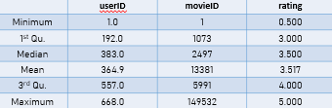
Exploring the data
Summary

Slide 6
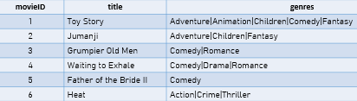
Exploring the data
Head(movie_data)

Slide 7

Preprocessing
I used cbind function to merge two data frames

Slide 8
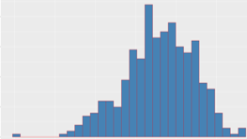
Preprocessing
I preprocessed the dataframe in such a way that movie is rated by at least 50 users and have at least 50 views. After applying this technique, only 420 watchers and 447 films remains.
This figure shows the distribution of average rating per user
After this step, I normalized the dataset to a common scale value

Slide 9

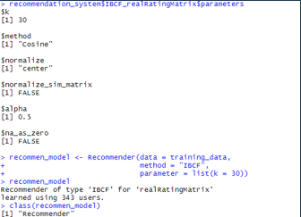
Building the system
I developed my system using item based collaborative filtering. This will find similarity between items regarding to ratings of users given to those items. I also split this data into train test

Slide 10
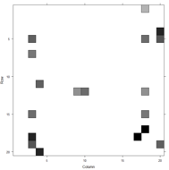

Getting the Model
I retrieve the model and generate the heat map containing the top 20 items and displayed the similarities between them
I used predict function to get the items which are similar and rank them appropriately.

Slide 11
The End

